Slide 1

What is NHS Continuing Care and Continuing Healthcare?
Funding from your local NHS
for children who have complex medical needs needing support above what is routinely available
adults who have complex medical needs above that which the local authority should normally support

Slide 2
Children and Young People’s Continuing Care (CC)
Up to 18th birthday
Adult Continuing Healthcare (CHC)
From 18th birthday onwards, but usually assessed for when age 17

Slide 3
What is it used for?
Can be used to fund or provide:
Home care packages
Personal Health Budgets
Chailey Clinical Services
Other community services including respite
Residential care homes post 19
Day services post 19
If your child does not qualify for CC/CHC then the local authority will provide support

Slide 4
How is it assessed?
Your local NHS (Integrated Care Board - ICB) has a team of Nurse Assessors in Continuing Care and Continuing Healthcare who organise and carry out the assessment using a National CC/CHC Framework
For Children’s Continuing Care it is often only the Nurse Assessor who carries out the assessment with parents
Be aware!
These assessments focus on what your child cannot do, be realistic
They can be upsetting and emotionally draining
For Adult Continuing Healthcare a Social Worker will often be part of the assessment too
Be prepared

Slide 5
How is it assessed?
The Nurse Assessor will request and gather written evidence from professionals involved with your child, with your consent
Tell them everyone who is involved
It may be helpful to keep 24 hour records of the care you provide at home, you may not realise how much you just do automatically
The Nurse Assessor (and Social Worker for adult CHC) will carry out the assessment using a Decision Support Tool (DST) in an assessment meeting with you
Know the DST and how your child should score
Ask for other professionals who know your child to attend
They will make a recommendation as to whether your child should qualify for CC/CHC, which then has to be agreed by a panel, and the care package decided. (You can appeal if your child is found non eligible). Eligibility is reviewed annually.

Slide 6
Who makes the referral to CC/CHC and when?
Children’s Continuing Care
A health, education or social care professional can make a referral to CC using a “pre-assessment checklist” with evidence, at any age below 18
Please tell us if your child already has CC
Adult Continuing Healthcare
A Social Worker (often from the local authority Transition team) will usually make the referral to CHC using a “pre-assessment checklist” with evidence, usually at age 17. We will discuss this in the school Future Placement Planning (FPP) meetings.

Slide 7
What does the assessment involve?
The Decision Support Tool (DST) is used nationally for all, and is divided into areas/domains:
Children’s CC
Breathing
Eating and drinking
Mobility
Continence
Skin and tissue viability
Communication
Drug therapies and medication
Psychological and emotional needs Other significant care needs
Seizures
Challenging Behaviour
Adult CHC
All of those in the left hand column plus cognition and other significant care needs

Slide 8
What does the assessment involve?
Each of the areas/domains is divided into levels:
No needs
Low
Moderate
High
Severe
Priority
The nurse assessor uses the evidence already submitted and discussion in the assessment meeting to decide what level your child should score – don’t be afraid to argue!

Slide 9
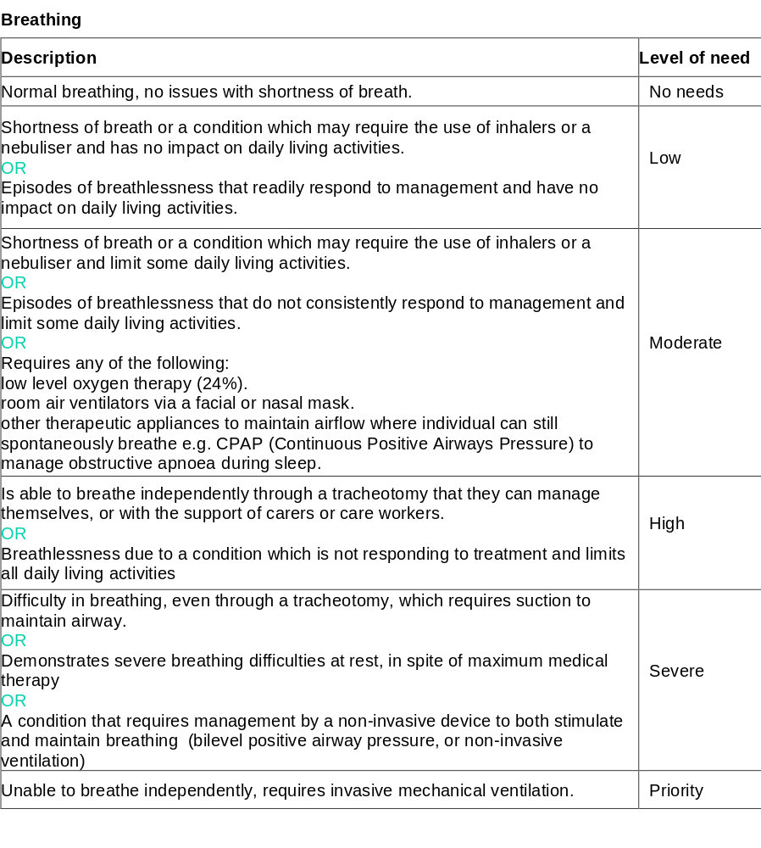

Slide 10
1.Breathing This is about the ability of a person to breathe independently without any difficulties. | Evidence of: Use of anti- biotics/ suctioning/ nebulisers/ oxygen/ secretion management etc. – Medications used for any conditions Tracheotomy/Asthma /Allergies/Apnoea/Aspiration BiPAP or CPAP mask? Chest Infections and any hospital admissions for this Include all support (care) plans & risk assessments.

Slide 11
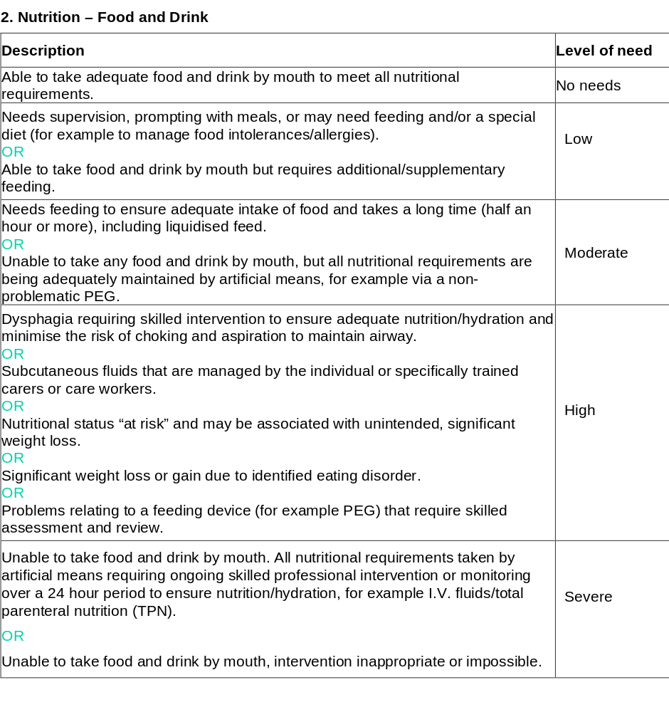

Slide 12
2.Nutrition This is about the ability of a person to eat and drink independently and get the right food and drinks for good health. | Evidence of: Current weight- evidence if risk of malnutrition Guidance for feeding needs and equipment- Speech and Language Therapy assessment – Dysphagia diagnosis, Reflux or other gastro conditions Medications PEG / JEJ – Dietician feeding regime Record of management of PEG site IV fluids /total parenteral nutrition (TPN) Last Consultant/ other specialist clinic letter- including confirmation of any interventions, tests etc and results Include all support plans & risk assessments.

Slide 13
How do you qualify for CC/CHC?
Children’s CC
a “severe” or “priority” level of need in at least one domain
or
3 “high” scores

Slide 14
How do you qualify for CC/CHC?
Adult CHC
1 “priority” level need
or
2 “Severe” level needs
Or
1 “severe” with needs in other domains
or
A number of domains with “high” and or “moderate” needs
Plus
Evidence about the Nature, Complexity, Intensity or Unpredictability of needs

Slide 15
How do I find out more?
Search “Children’s continuing care gov.uk”
https://www.gov.uk/government/publications/children-and-young-peoples-continuing-care-national-framework
Search “continuing Healthcare gov.uk”
https://www.gov.uk/government/publications/national-framework-for-nhs-continuing-healthcare-and-nhs-funded-nursing-care

